Slide 1
Project 1
Lesson 7.1

Slide 2
Learning Objectives
Introduction to Agile Software Development
Minimal Viable Product (MVP)
Creating GitHub Issues
Writing User Stories
Agile Meetings
Git Branching and Pull Requests

Slide 3

What is a project?

Slide 4

Project: Any undertaking, carried out individually or collaboratively and possibly involving research or design, that is carefully planned (usually by a project team) to achieve a particular aim.

Slide 5
How do we carefully plan a project?

Slide 6

Project Management
The practice of initiating, planning, executing, controlling, and closing the work of a team to achieve specific goals and meet specific success criteria at the specified time.
The primary challenge of project management is to achieve all of the project goals within the given constraints.
wikipedia.org
Notes:
shutterstock_94248952

Slide 7
What is the definition of agile?

Slide 8
agile [ aj-uhl, -ahyl ]
01
Quick and well-coordinated in movement; lithe: an agile leap.
02
Active; lively: an agile person.
03
Marked by an ability to think quickly; mentally acute or aware: She's 95 and still very agile.
dictionary.com

Slide 9
What is agile software development?

Slide 10
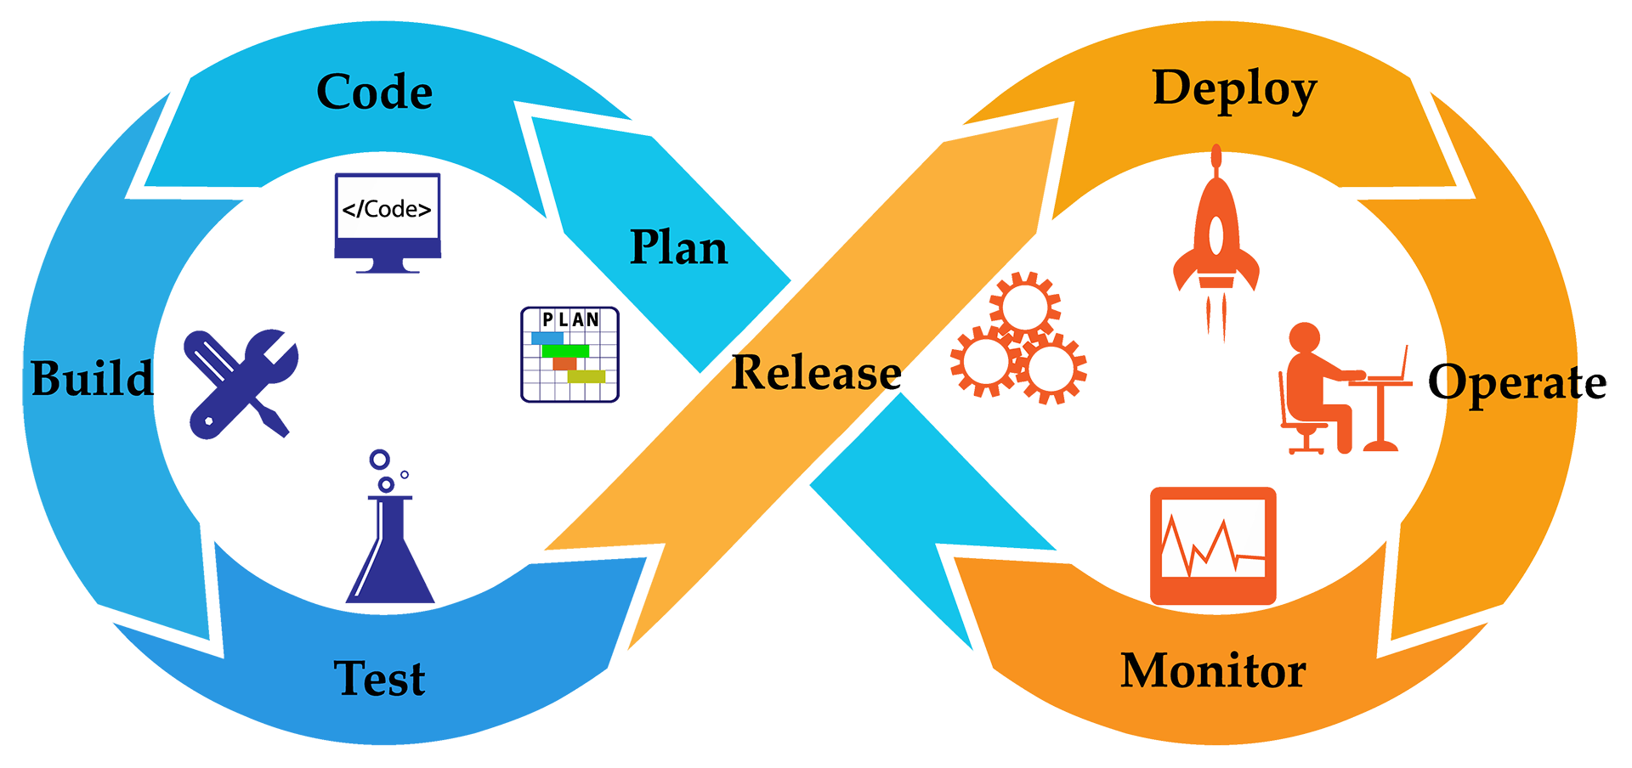
Agile Software Development
Agile software development is an iterative approach to software development.
wikipedia.org
Notes:
shutterstock_538046059

Slide 11
Agile Software Development
Deliver Value
Respond to Change
Teams deliver value to their customers faster by working incrementally rather than working towards a big launch.
Teams improve and respond to change by continuously evaluating project plans, requirements and user needs.

Slide 12
What is iterative development?

Slide 13
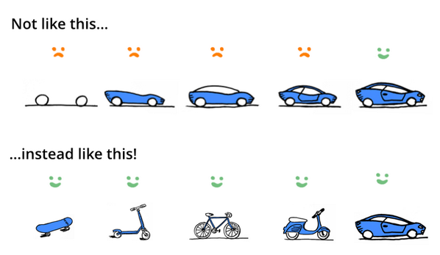
Iterative and Incremental Development
Working software is the primary measure of progress

Slide 14
What is an MVP?

Slide 15


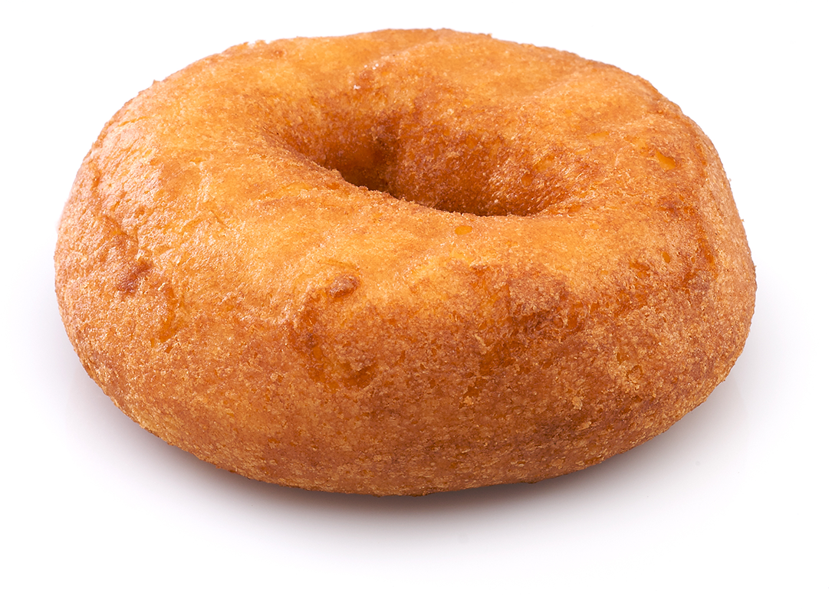
Minimum Viable Product
A product with just enough features to satisfy early customers and provide feedback for future product development
Minimum Viable Product: Product Vision:
wikipedia.org
Notes:
Shutterstock_46018207
shutterstock_107698130

Slide 16
How do we determine our MVP?

Slide 17

Determining a Minimum Viable Product
Ask Questions!
Who is your audience?
What is the problem that the product will address?
How does the product solve that problem?

Slide 18
What is a user story?

Slide 19
User stories
As a <type of user>
Who are we building this for?
AS A marketing analyst
I want <some goal>
What is the user trying to achieve?
I WANT to see referral traffic
(so that <benefit>).
Why do they want to achieve this?
SO THAT I can convert more leads

Slide 20
User stories
As a <type of user>
Who are we building this for?
AS A marketing analyst
I want <some goal>
What is the user trying to achieve?
I WANT to see referral traffic
(so that <benefit>).
Why do they want to achieve this?
SO THAT I can convert more leads

Slide 21
User stories
As a <type of user>
Who are we building this for?
AS A marketing analyst
I want <some goal>
What is the user trying to achieve?
I WANT to see referral traffic
(so that <benefit>).
Why do they want to achieve this?
SO THAT I can convert more leads

Slide 22
What is acceptance criteria?

Slide 23
User stories
GIVEN some precondition
GIVEN I am an authenticated user
WHEN I do some action
WHEN I request a range of referral traffic
THEN I expect some result
THEN a chart is generated

Slide 24
User stories
GIVEN some precondition
GIVEN I am an authenticated user
WHEN I do some action
WHEN I request a range of referral traffic
THEN I expect some result
THEN a chart is generated

Slide 25
What is an Issue?

Slide 26
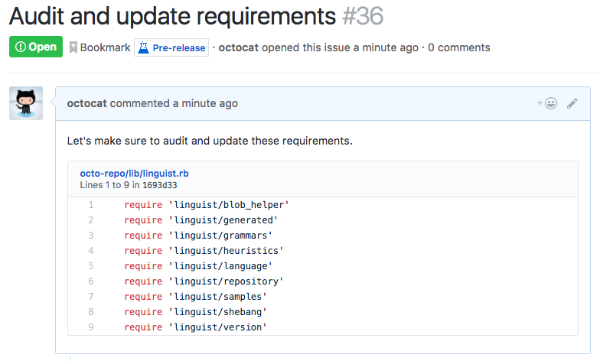
Issues
Use issues to track ideas, enhancements, tasks, or bugs for work on GitHub.
help.github.com

Slide 27
Issues

Slide 28
Student Activity: 1-user-stories User stories help provide context for a development team and their efforts moving forward
Notes:
5 minutes
1-user-stories

Slide 29
What is kanban?

Slide 30



Kanban
Kanban is a project management tool that visualizes work through cards representing User Stories or Issues.
In their simplest form, Kanban boards are broken into three columns:
To Do | In Progress | Done
Cards begin in the To Do column and are moved from left to right as work is started and completed.

Slide 31
Kanban

Slide 32
Student Activity: 2-github-projects Kanban boards help developers visualize work and keep track of the status of issues.
Notes:
10 minutes

Slide 33
What is daily scrum?

Slide 34
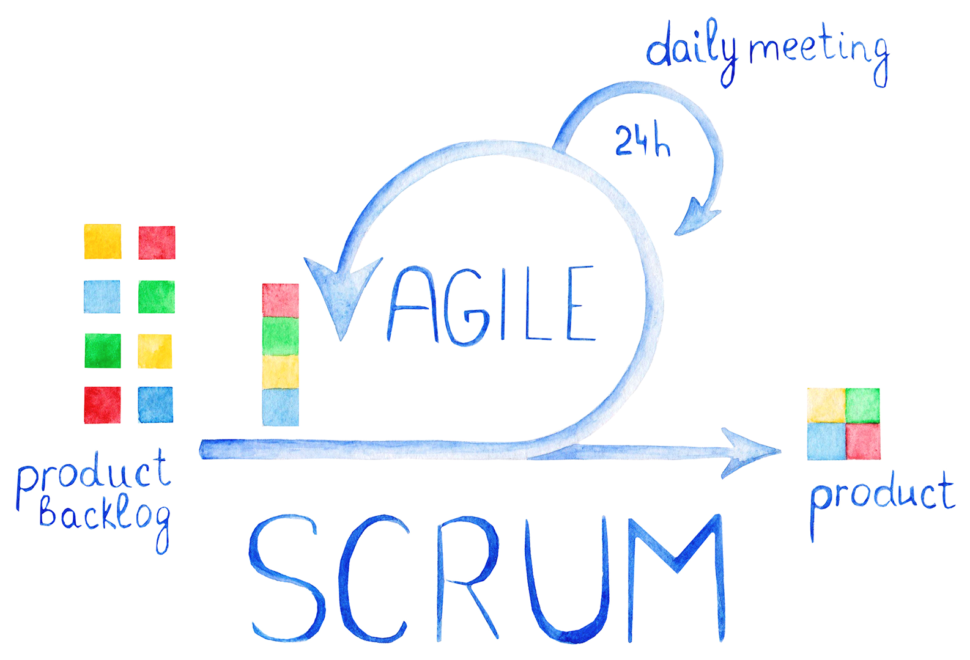
Stand-Up Meetings
01
What was accomplished?
02
What are your goals?
03
Are there any obstacles to achieving your goals?
Notes:
shutterstock_757928980

Slide 35

Project Timeline
Day 1 | Day 2
Divide into groups. Write a user story. Create a wireframe. Create a user flow diagram. Submit project proposal for approval. | Dive in to project development.
Day 3 | Day 4
Continue project development. | Continue project development.
Day 5 | Day 6
Continue project development. Prepare for presentations. | Give presentations!

Slide 36

Get Professional
Projects are portfolio pieces
Use Project Week as an opportunity to push yourself and prove what you know.

Slide 37
Project Requirements
Must use at least two server-side APIs
Must use a CSS framework other than Bootstrap
Use at least one new third-party API
Must have a polished, mobile-first UI
Must meet good quality coding standards (indentation, scoping, naming, etc.)
Does NOT use alerts, confirms, or prompts (look into modals).
Must be deployed to GitHub Pages
Must be interactive (i.e: accept and respond to user input)

Slide 38
Presentation Requirements
You will be responsible for preparing a formal, 10-minute presentation that covers the following:
Elevator pitch: a one minute description of your application
Concept: What is your user story? What was your motivation for development?
Process: What were the technologies used? How were tasks and roles broken down and assigned? What challenges did you encounter? What were your successes?
Demo: Show your stuff!
Directions for Future Development
Links to to the deployed application and the GitHub repository

Slide 39
Project Metrics
Your project will be evaluated on the following:
Concept
Design
Functionality
Collaboration
Presentation

Slide 40
API Suggestions
Stick to APIs that do all of the following:
Allow cross-origin resource sharing (CORS)
Require simple or no authentication
Return a JSON response
Are well documented
For a list of free APIs see: https://github.com/public-apis/public-apis

Slide 41
Today’s Project Checklist
Create a short (1 page) proposal that contains the following:
Project title
Project description
User story
Wireframe or sketch of the design
APIs to be used
Rough breakdown of tasks

Slide 42
Questions?

Slide 43
Project 1 Groups
Group 1
X, Y, Z
Group 2
X, Y, Z
Group 3
X, Y, Z
Group 4
X, Y, Z
Group 5
X, Y, Z
Group 6
X, Y, Z
Group 7
X, Y, Z
Group 8
X, Y, Z

